Slide 1

Manufacture of Scroll Saw
KATHMANDU UNIVERSITY
BATCH:2024(1ST YEAR 2ND SEMESTER )
Team Members
Supervisor
David Ojha
Kushal Dahal
Pratik Subedi
Shirish Karmacharya
Asst. Prof Bijendra Shrestha
1

Slide 2
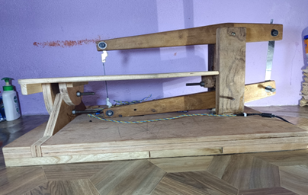
INTRODUCTION
Scroll saw is a small electric operated saw used to cut intricate curves in wood, metals and other materials.
It is primarily used for making intricate and detailed cuts in wood, metals, and other materials.
Scroll saws use thin, straight blades, which allow for intricate designs and tight curves.
Scroll saws operate using a motor to move the blade up and down, allowing for intricate cutting motions.
Fig:Scroll Saw
2

Slide 3
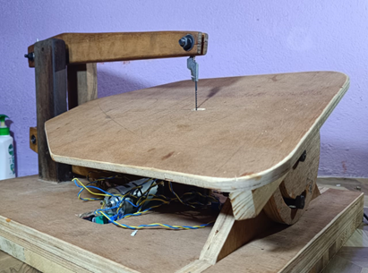
OBJECTIVES
Primary Objective:
To manufacture a functional scroll saw.
Secondary Objective:
To cut precisely in wood.
To evaluate the safety.
3

Slide 4
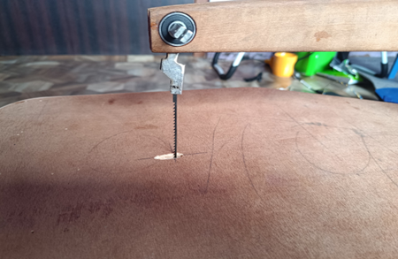
SIGNIFICANCE
The Significance of Scroll saw are:
1. Scroll saws are easy to use.
2. Scroll saw offers better control and safety.
3.It is capable of cutting complex shapes and patterns.
4

Slide 5
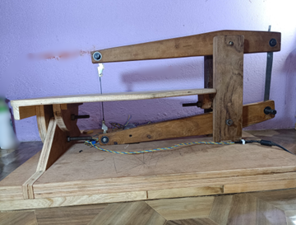
LIMITATIONS
The limitations are:
Blade may break due to thin line.
The clamping of the motor shaft and the circular power transfer can be loose after excessive use.
Cutting strokes in one direction.
Different blades should be used while
cutting different materials.
.
5

Slide 6
LITERATURE REVIEW
Precision Cutting: Scroll saws excel in intricate and detailed cuts using a vertically reciprocating blade.
Key Features: Includes a DC motor, adjustable spring tension, and various blade options for different materials.
Market Growth: Significant expansion anticipated from 2023 to 2030, with major players like SEG, Grizzly, and Craftsman.
Future Trends: Innovations will enhance cutting efficiency, reduce noise, and broaden capabilities.
6

Slide 7
THEORETICAL FRAMEWORK
Reciprocating Motion: The scroll saw uses a back-and-forth motion to convert electrical energy into mechanical energy for cutting intricate shapes.
Parallel Swing Arm: The design ensures the saw blade remains perpendicular to the table, maintaining stability and cutting accuracy.
Variable Speed Controller: Allows users to adjust the blade speed to suit different materials and cutting intricacies, enhancing versatility.
Four-Bar Mechanism: Converts rotational motion into reciprocating motion, ensuring synchronized movement of the parallel arms and reducing vibrations for precise cuts.
7

Slide 8
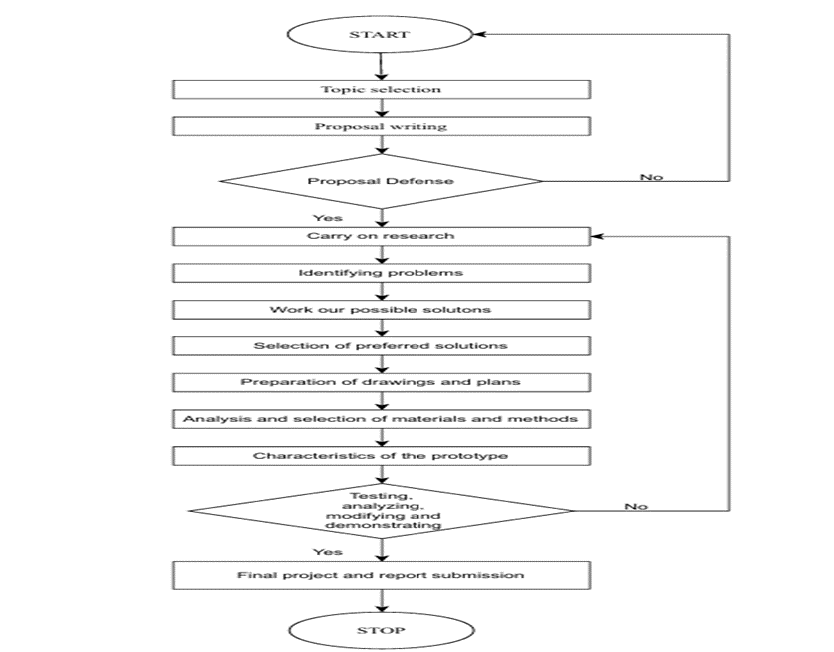
STUDY DESIGN
8

Slide 9


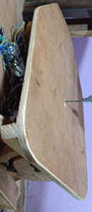



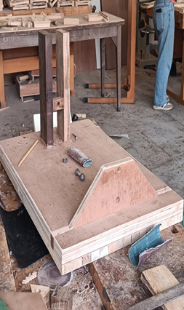
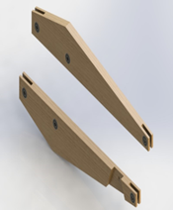


FABRICATION PROCESS
Final assembly
Fabrication of base and pillars
Fabrication of tilting table
Fabrication of swing arms
Assembly

Slide 10
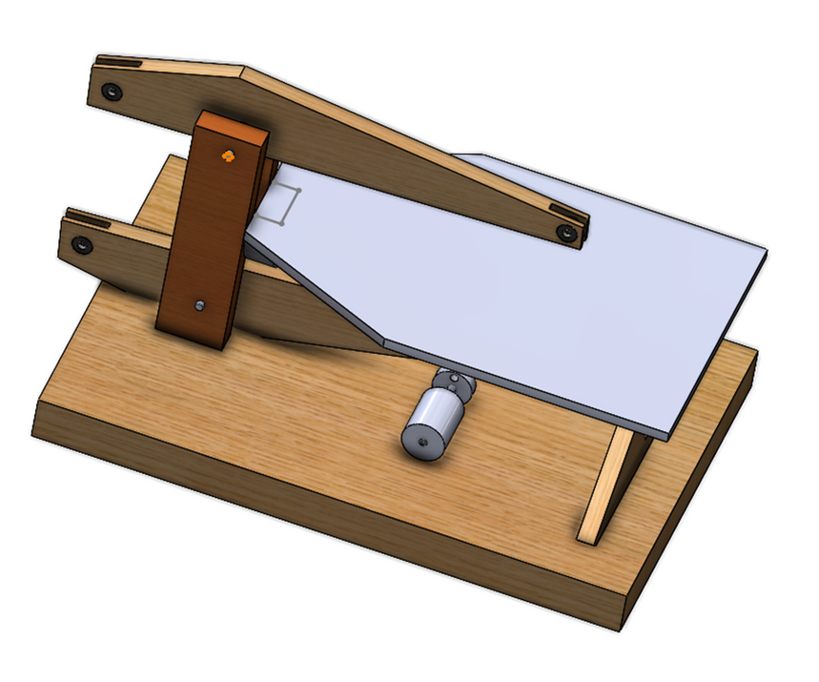
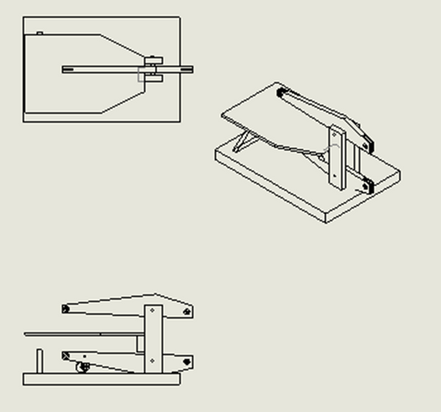

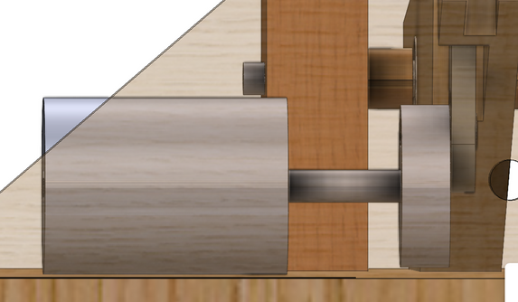
CAD MODEL OF SCROLL SAW

Slide 11
Budget Evaluation
SN | MATERIAL AND COMPONENTS | QUANTITY | Rate (RS.) | Amount (NPR)
1. | AC Cord | 1 | 300 | 300
2. | Motor 775 | 1 | 900 | 900
3. | Bearing | 14 | 150 | 2000
4. | Blade | 1 | 250 | 250
5. | Variable speed controller | 1 | 370 | 370
6. | DC adapter | 1 | 800 | 800
7. | Nut and bolts | 10 | 10 | 100
8. | Toggle Switch | 1 | 50 | 50
9. | O rings | 6 | 10 | 60
11. | Soldering Wire | 3m | 20 | 90
12. | Wire | 3m | 20 | 90
 | Total |  |  | 5,010
11

Slide 12
RESULT AND DISCUSSION
The scroll saw delivered accurate results with minimal deviation, successfully cutting various patterns and curves.
The motor operated smoothly from 3000 to 12000 RPM, enabling adaptable cutting across different materials.
The parallel arm design and bearing system effectively reduced vibrations and maintained blade alignment, but the wooden base and pillars showed instability at higher speeds.
Future models should use more durable materials to enhance stability and reduce vibrations, refine blade clamps to prevent slippage, and address overall material durability for improved reliability.
12

Slide 13
CONCLUSION AND RECOMMENDATION
The enhanced scroll saw demonstrated effective precision cutting with a variable speed motor and parallel arm design.
Problems with the wooden base instability, occasional blade clamp slippage, and material durability were noted, affecting overall effectiveness.
Upgrade the base and pillars to durable materials, redesign blade clamps, implement vibration dampening, and conduct extensive testing to address these challenges.
Consider integrating modern technologies like digital controls and laser guides for increased precision and user-friendliness in future models.
13

Slide 14

THANK YOU

